Slide 1
Mfront user meeting, November, 19th, 2024 MFront/MGIS for the solution of a fictitious non-linear grid problem in Arbitrary Lagrange-Euler CFD simulations
Vincent FAUCHER⁽¹⁾, Adela PUSCAS⁽²⁾
⁽¹⁾CEA, IRESNE, Nuclear Technology Department, Cadarache, France
⁽²⁾CEA, ISAS, Structure and Systems Modelling Departement, Paris-Saclay, France
Special thanks to Olivier JAMOND and Pascal BOUDA for the MGIS classes from MANTA and the general support with MGIS/Mfront

Slide 2
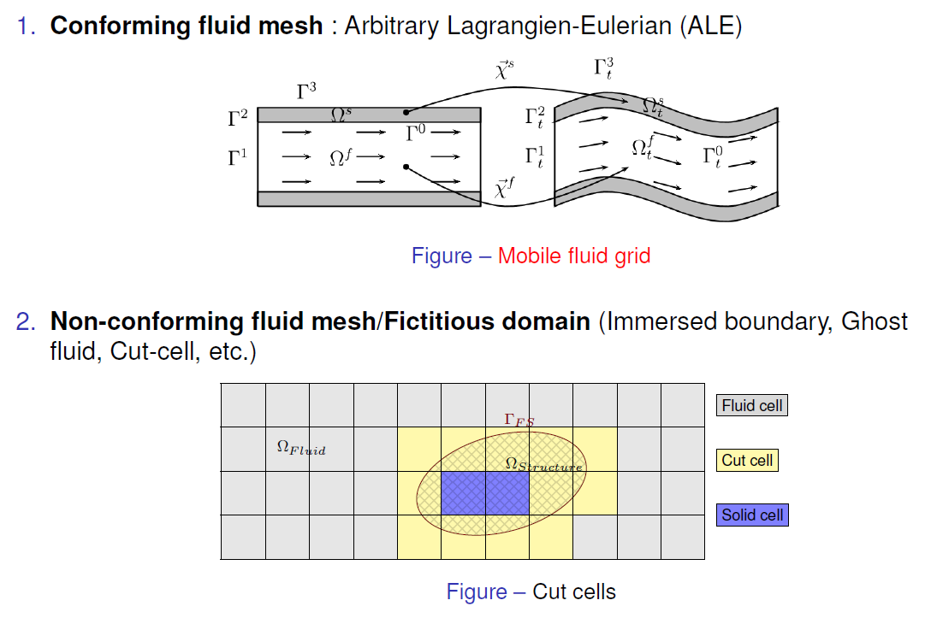
Brief reminder of the contexte for fluid-structure interaction
Need for an arbitrary method to update interior grid points from the imposed Lagrangian motion on the fluid-structure boundary, with the objective of preserving the best aspect ratio for the fluid mesh cells
/ 14

Slide 3
Ask for the program!
A.
Strategy for large scale grid motion in ALE simulations
Basics of ALE fluid grid motion in CFD software
Known shortcomings…
An innovative strategy in two steps
B.
Implementation key-points and some results
Complete algorithm and solving steps
Test 0: proof-of-concept with EPX
Test 1: square in translation
Test 2: towards extreme mesh compression
C.
Short conclusion
/ 14

Slide 4
Strategy for large scale grid motion in ALE simulations
A
/ 14

Slide 5
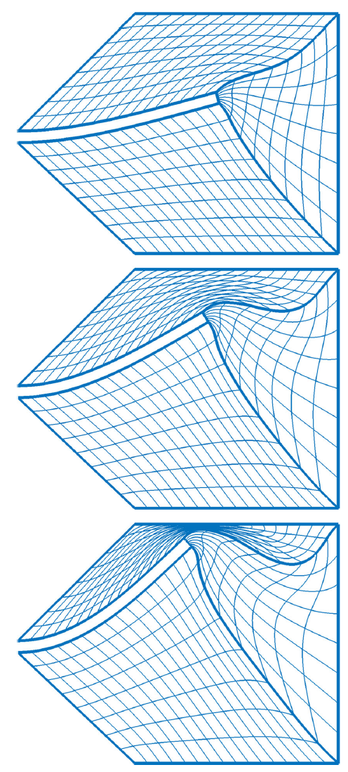
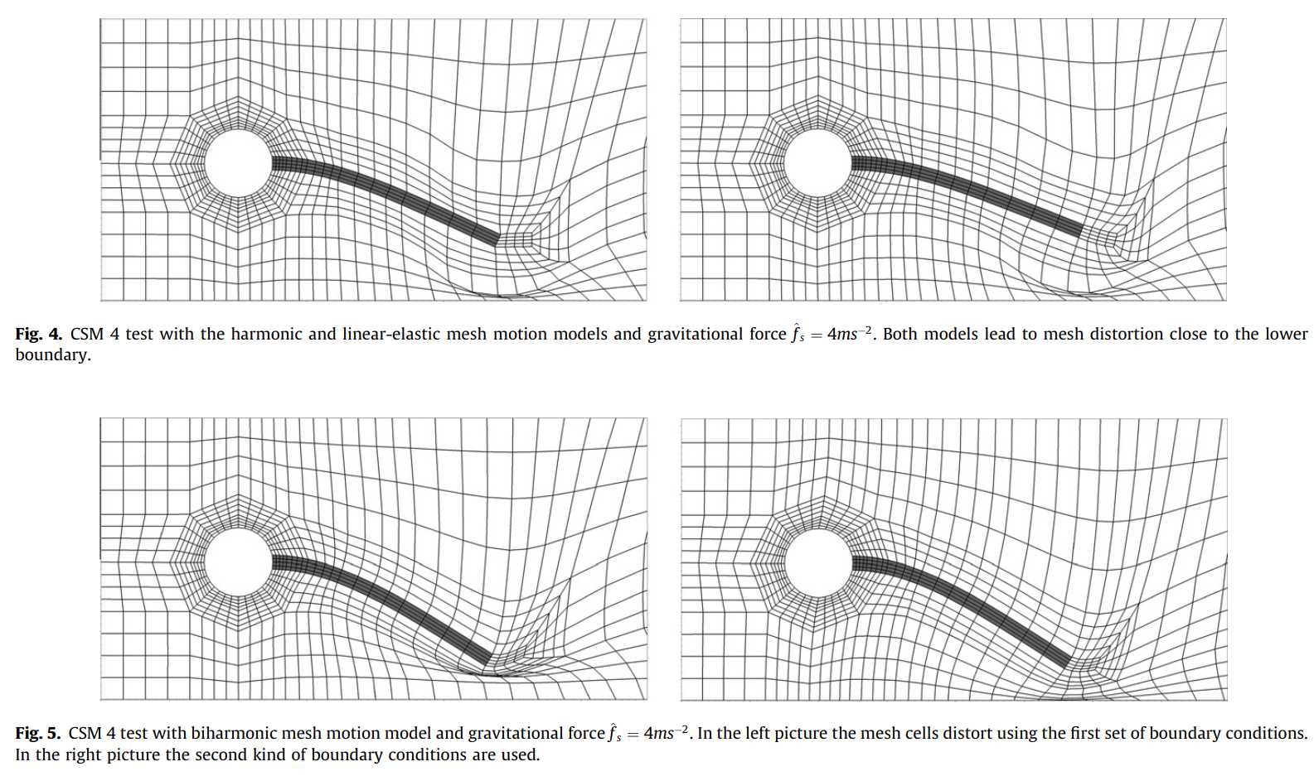
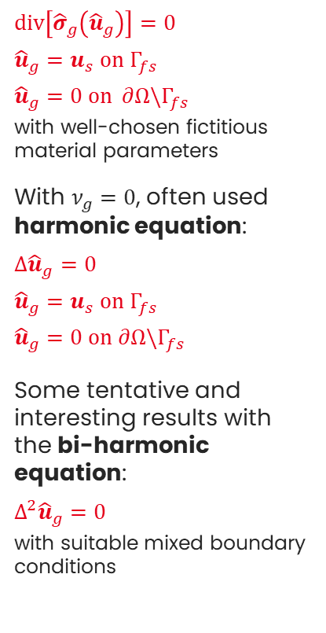
Basics of ALE fluid grid motion in CFD software
Classical expression of the grid motion problem
Some results…
$div\left[{\hat{σ}}_{g}\left({\hat{u}}_{g}\right)\right]=0$
${\hat{u}}_{g}=u_{s} on Γ_{fs}$
${\hat{u}}_{g}=0 on ∂Ω\backslash Γ_{fs}$
with well-chosen fictitious material parameters
With $ν_{g}=0$, often used harmonic equation:
$Δ{\hat{u}}_{g}=0$
${\hat{u}}_{g}=u_{s} on Γ_{fs}$
${\hat{u}}_{g}=0 on ∂Ω\backslash Γ_{fs}$
Some tentative and interesting results with the bi-harmonic equation:
$Δ^{2}{\hat{u}}_{g}=0$
with suitable mixed boundary conditions
Thomas Wick, Fluid-structure interactions using different mesh motion techniques, Computers & Structures, Volume 89, Issues 13–14, 2011
Shamanskiy, A., Simeon, B. Mesh moving techniques in fluid-structure interaction: robustness, accumulated distortion and computational efficiency. Comput Mech 67, 583–600 (2021)
Focus on bi-harmonic equation
Focus on non-linear fictitious grid problem
/ 14

Slide 6
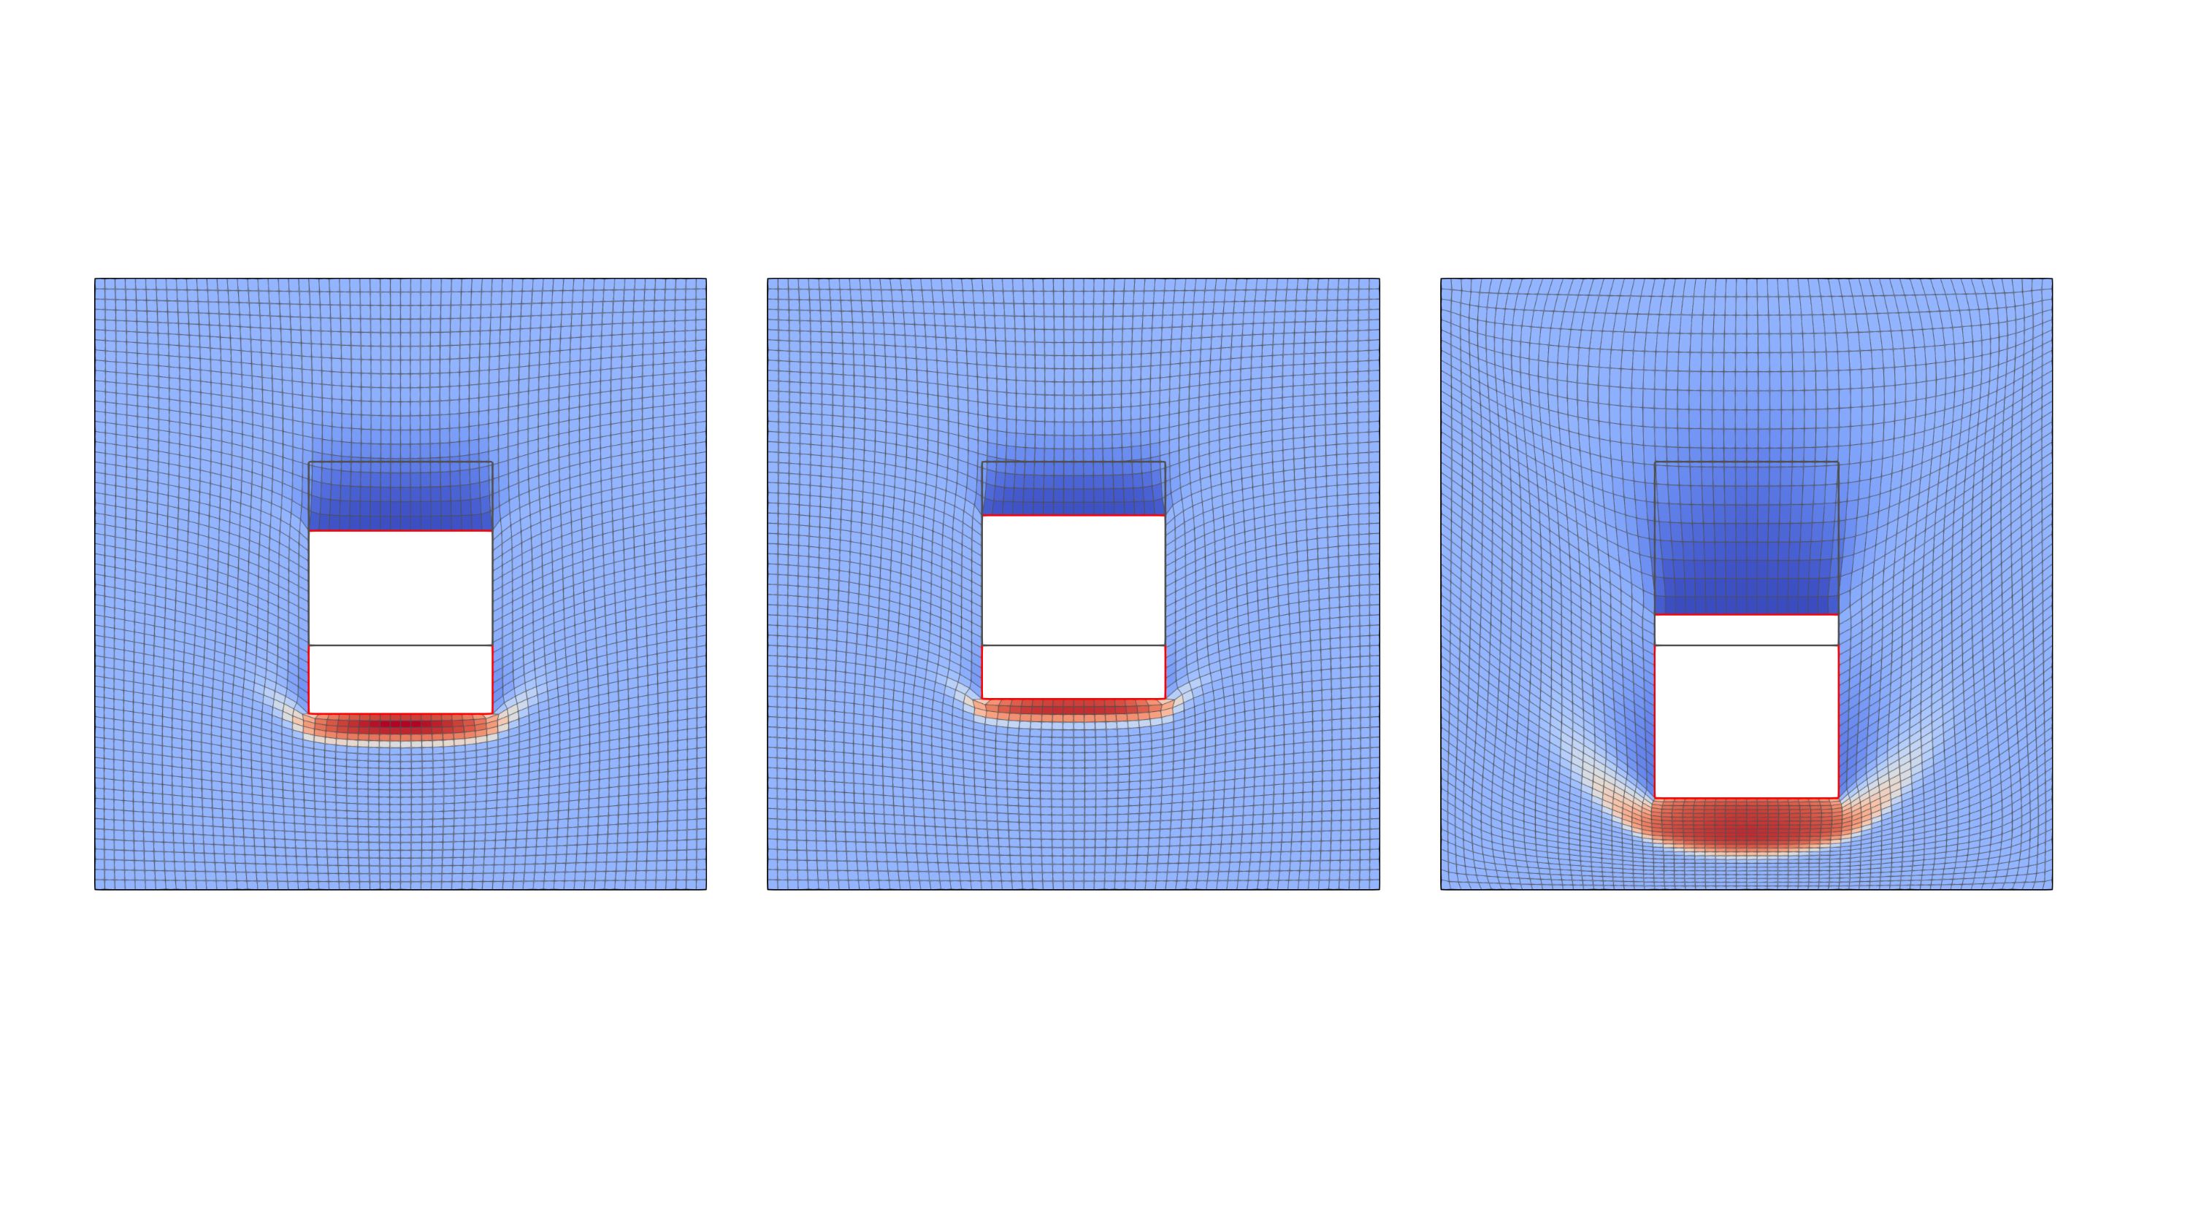
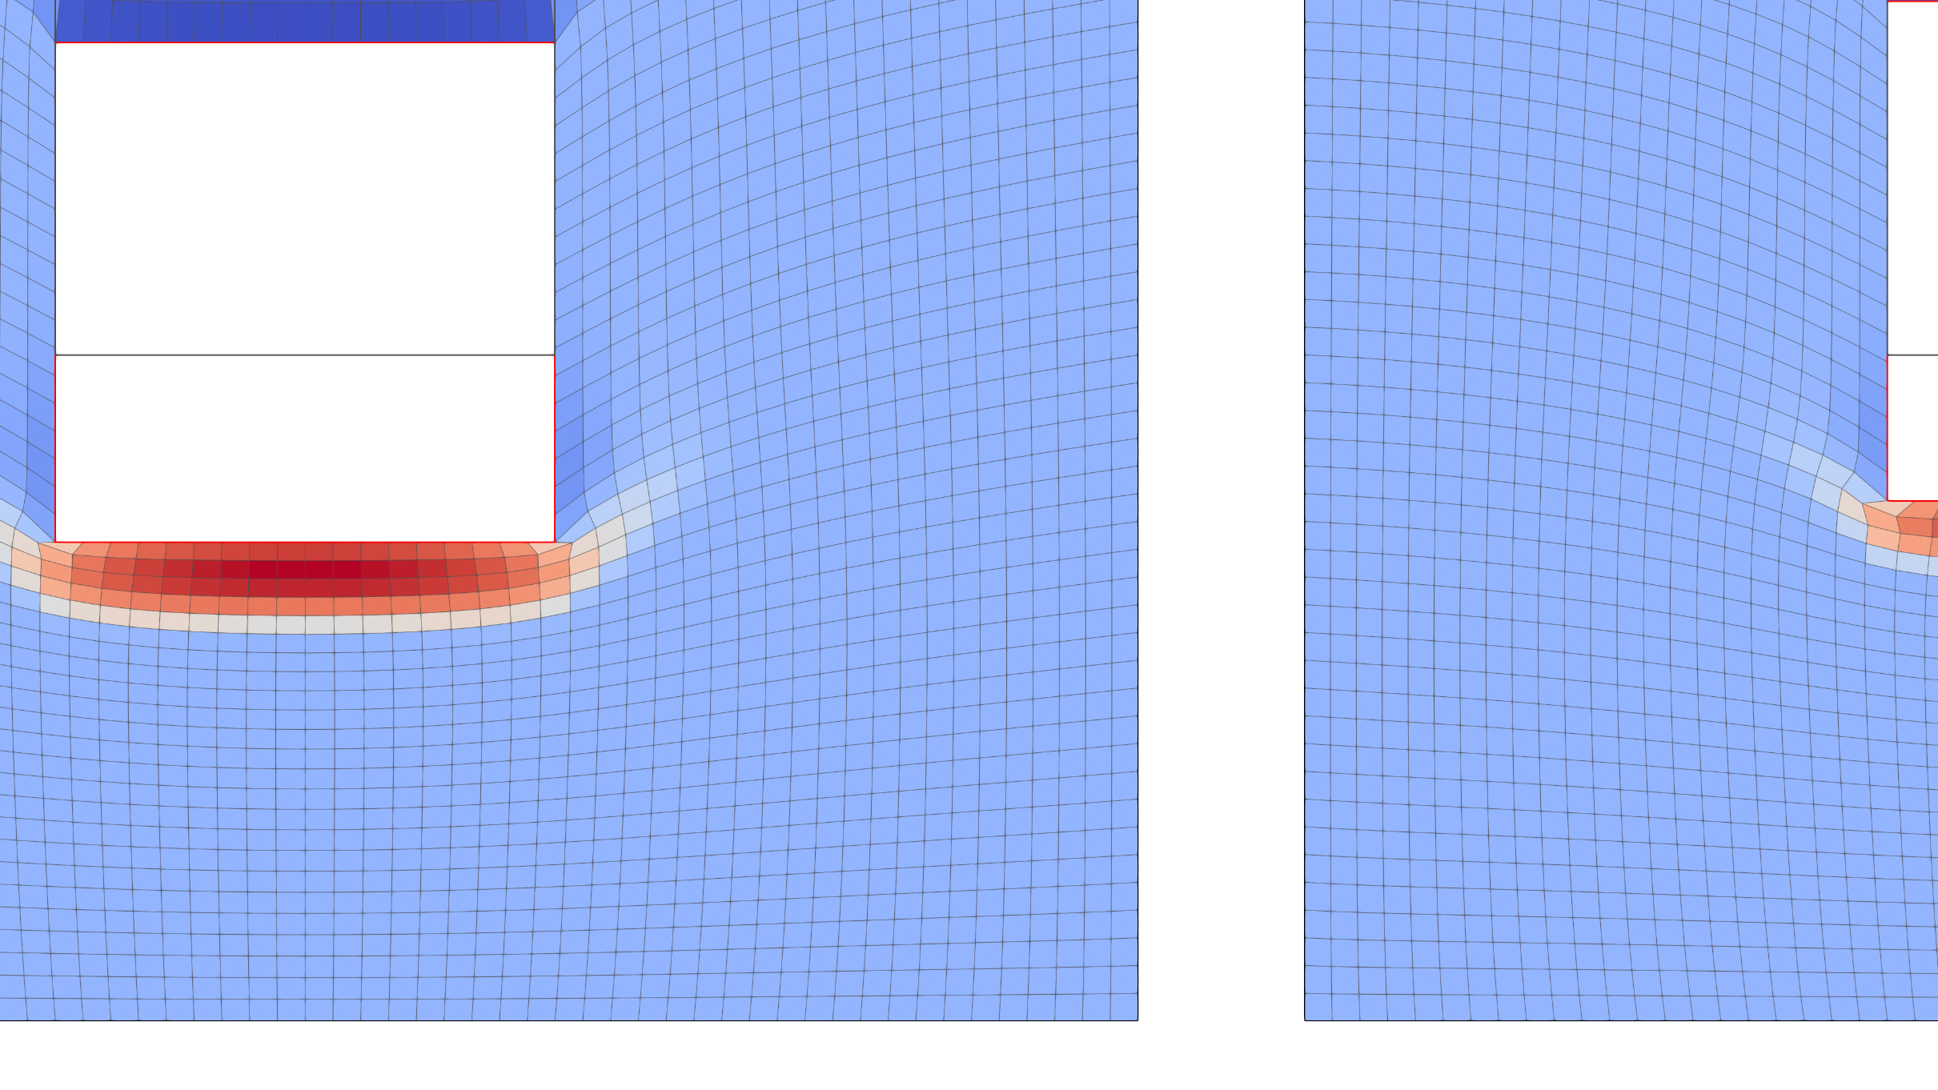
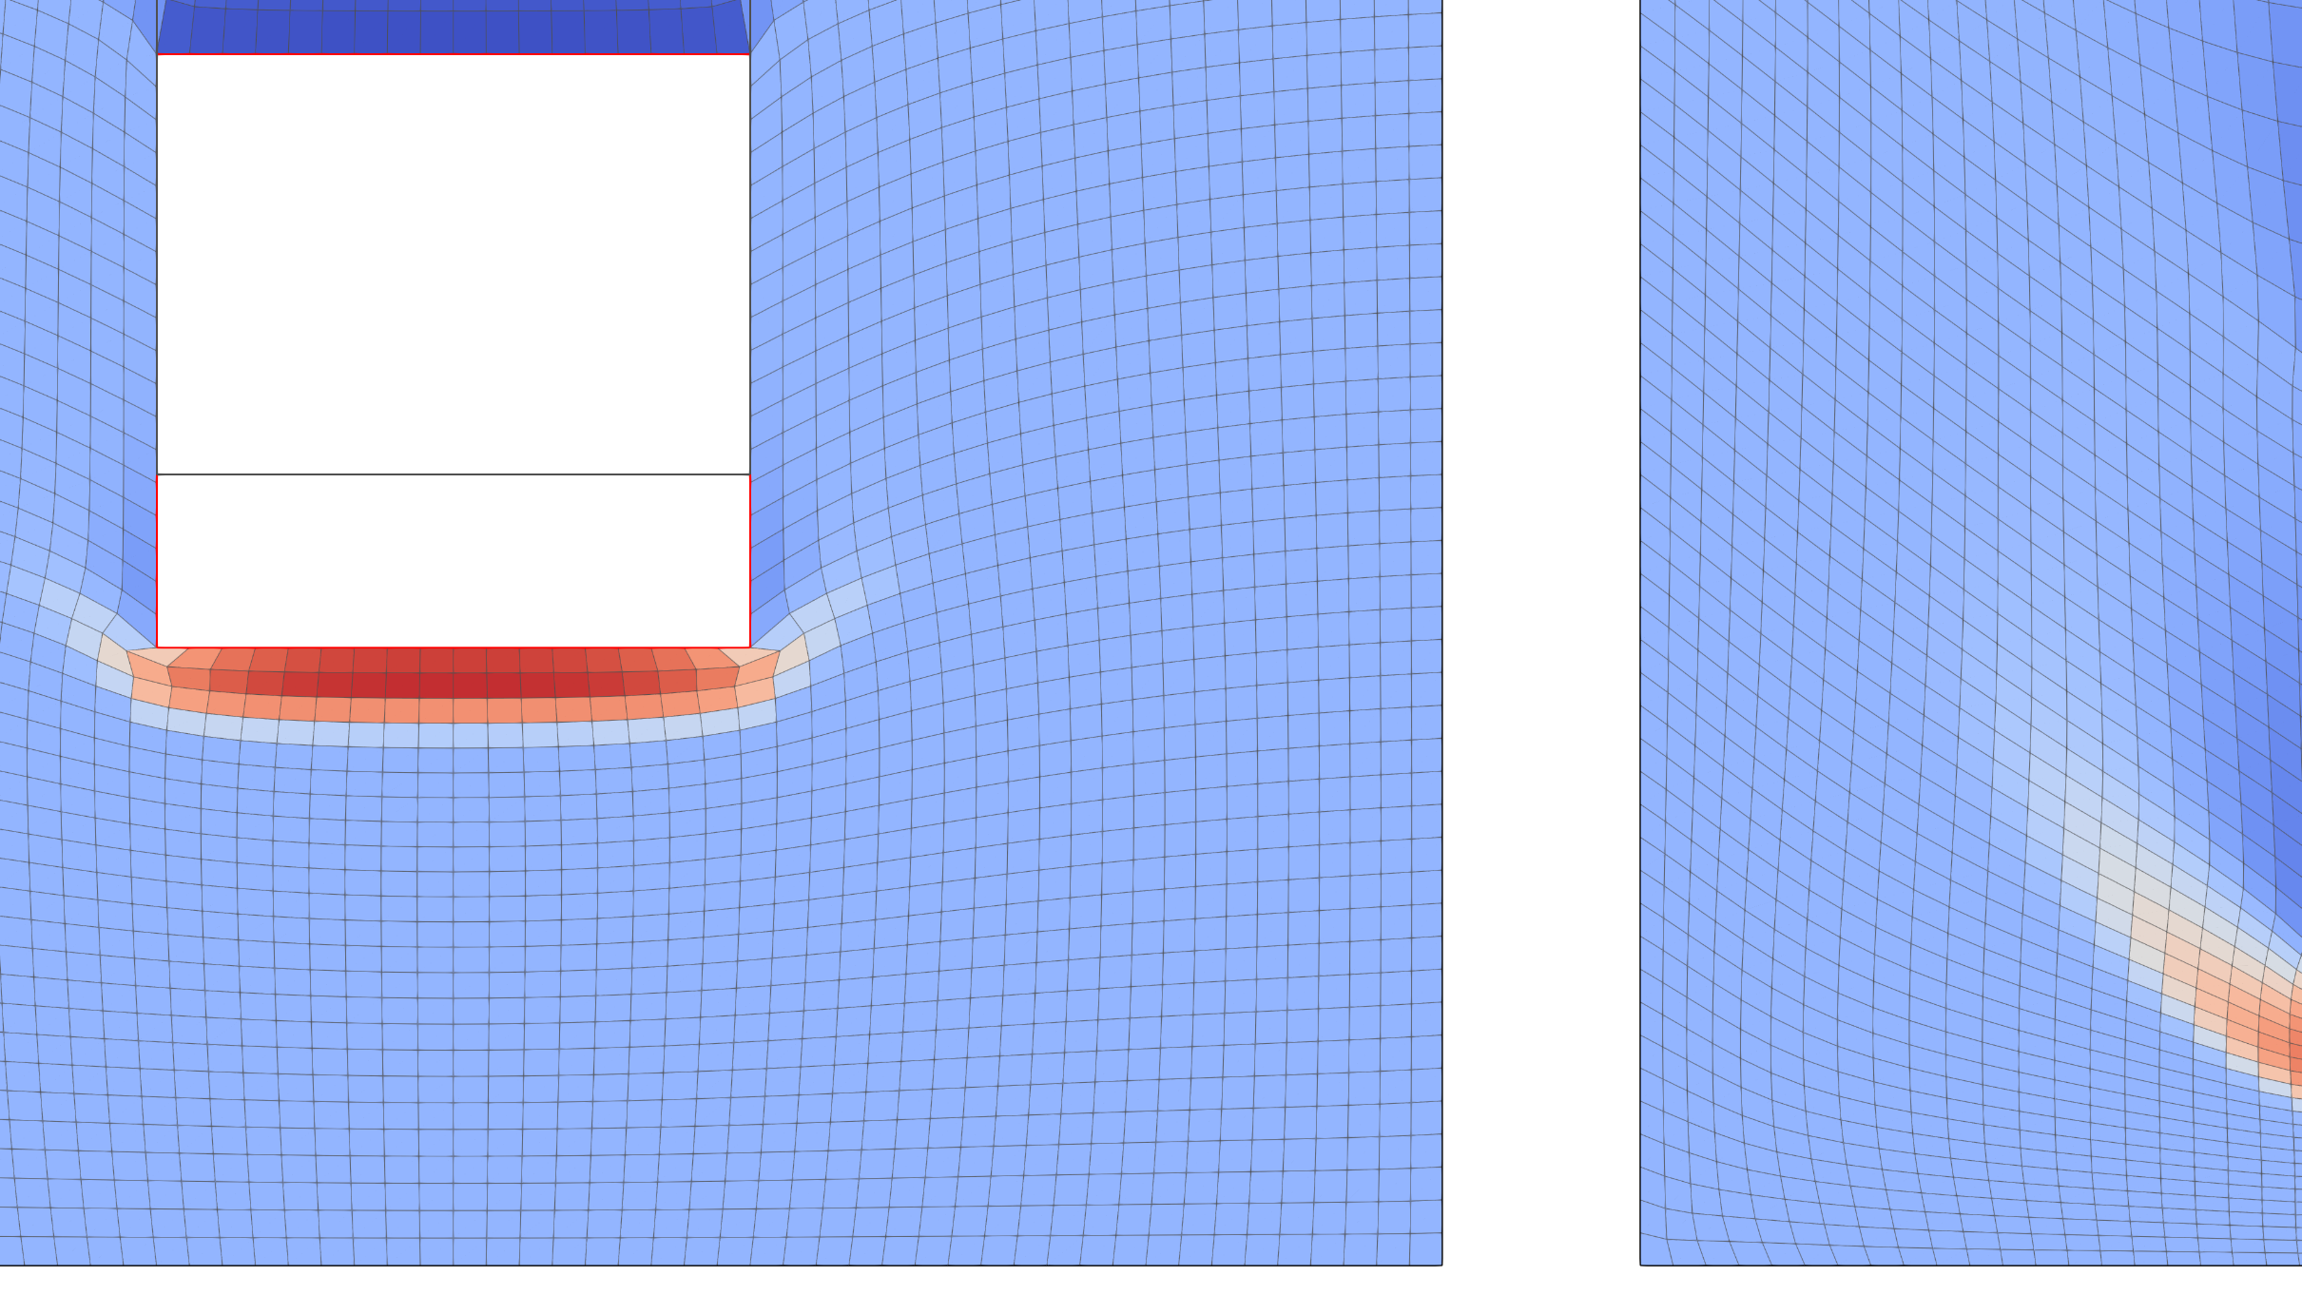

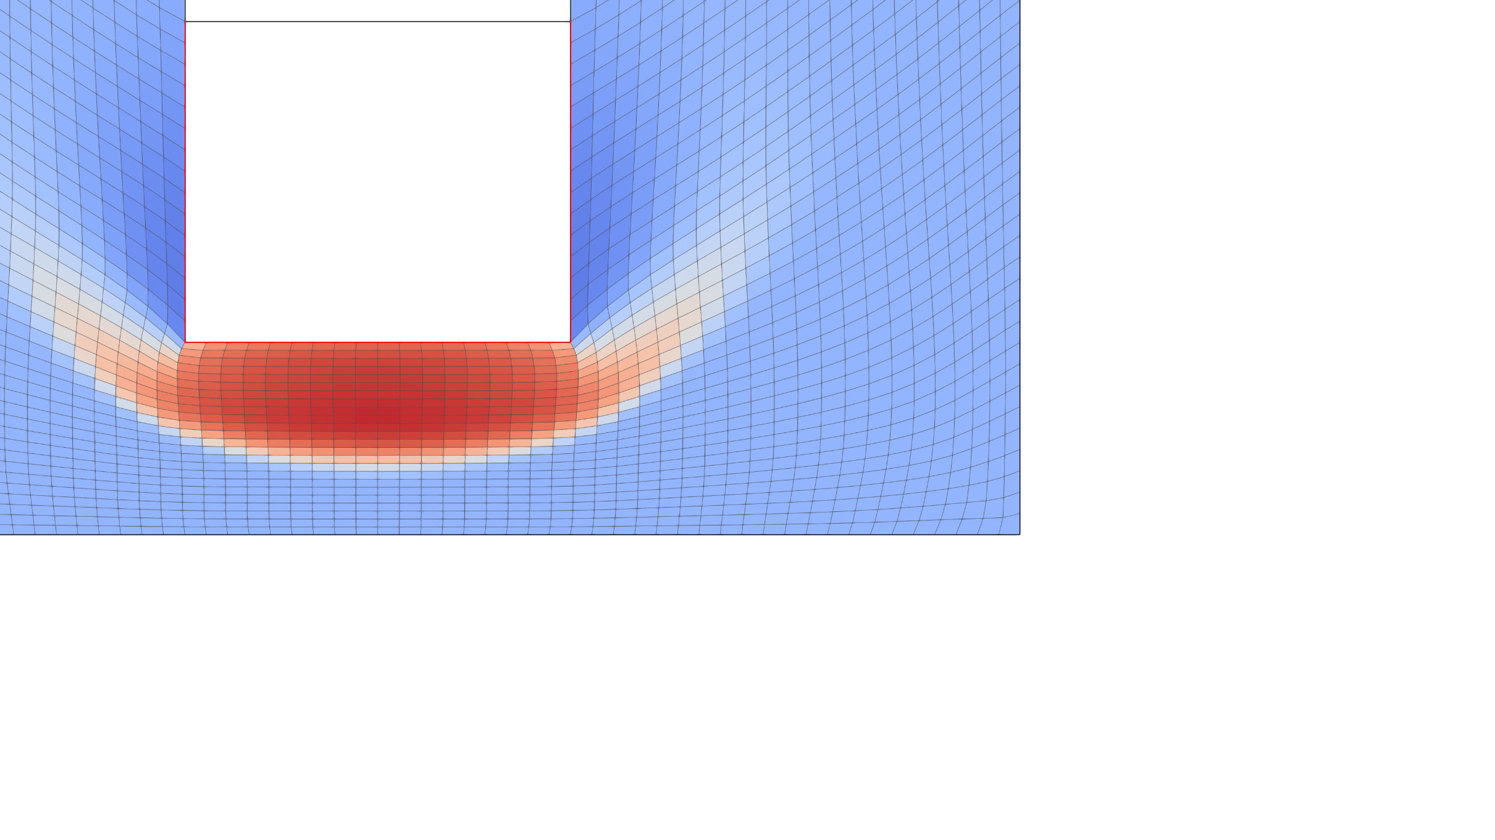
Known shortcomings…
1. Additional numerical cost
Needed to solve any kind of elliptic problem with a scaling in N log(N) at best…
Minimum overhead of ~30% regarding the complete fluid solution
Harmonic equation
Elastic model (ν = 0.3)
2. Robustness for large structural motion
Harmonic and linear elastic fictitious problems quickly reaches limits for finite displacements
Initial position of the structure
3. Flexibility and software requirements when you go for complex grid problems
Bi-harmonic equation shows interesting results at the price of a specific solver/discretization and boundary conditions
Best robustness obtained with full non-linear fictitious problem close to incompressibility, but…
non-linear implicit solver (Newton-Raphson) requested and often unavailable in CFD software
unaffordable increase of the cost of the grid problem, compared to the physical fluid solver
Quasi-incompressible Ogden model
/ 14

Slide 7
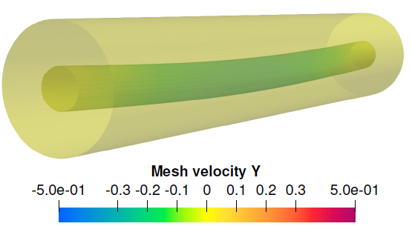
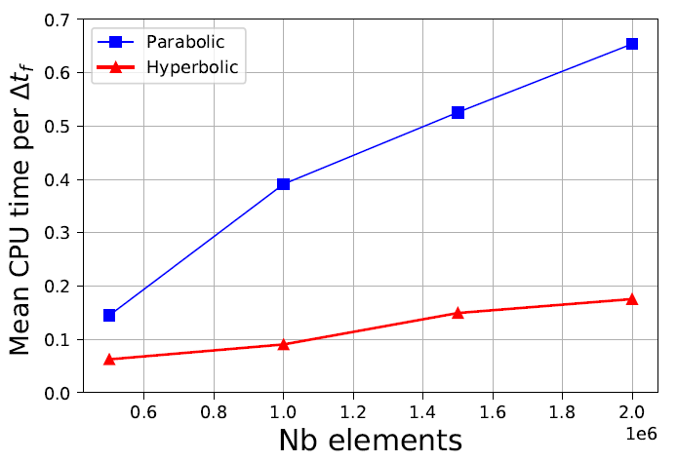


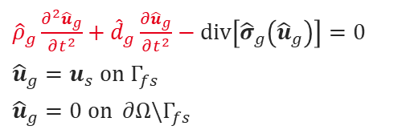
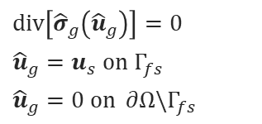
An innovative strategy in two steps
Step 1
Switch from elliptic problem to hyperbolic problem for the grid motion
$div\left[{\hat{σ}}_{g}\left({\hat{u}}_{g}\right)\right]=0$
${\hat{u}}_{g}=u_{s} on Γ_{fs}$
${\hat{u}}_{g}=0 on ∂Ω\backslash Γ_{fs}$
${\hat{ρ}}_{g}\frac{∂^{2}{\hat{u}}_{g}}{∂t^{2}}+{\hat{d}}_{g}\frac{∂{\hat{u}}_{g}}{∂t^{2}}−div\left[{\hat{σ}}_{g}\left({\hat{u}}_{g}\right)\right]=0$
${\hat{u}}_{g}=u_{s} on Γ_{fs}$
${\hat{u}}_{g}=0 on ∂Ω\backslash Γ_{fs}$
Wave propagation problem
High damping level to prevent oscillations of the grid
Solvable with explicit time integration with no global solver
Conditional stability and time-multiscale solution mandatory
Straitghforward parallel scaling
3D test up to 2 millions tetrahedra with linear model for internal grid forces
Evolution of the cost associated with grid movement as a function of the size of the system favourable to the hyperbolic problem if the time step ratio is controlled
Leprevost, A., Faucher, V., Puscas, M.A. A Computationally Efficient Dynamic Grid Motion Approach for Arbitrary Lagrange–Euler Simulations. Fluids 2023, 8, 156.
Step 2
Easy management of any non-linear model with explicit time integration through Mfront/MGIS
Minimum implementation in host physical software (here, TrioCFD, https://github.com/cea-trust-platform/TrioCFD-code)
Grid motion from simple loops over the fluid cells (used as geometrical support for finite elements) to:
compute grid deformation gradient
pass it to Mfront and get stress in return
finally compute nodal internal fictitious forces
Complex integration of material behavior
/ 14

Slide 8
Implementation key-points and some results
B
/ 14

Slide 9
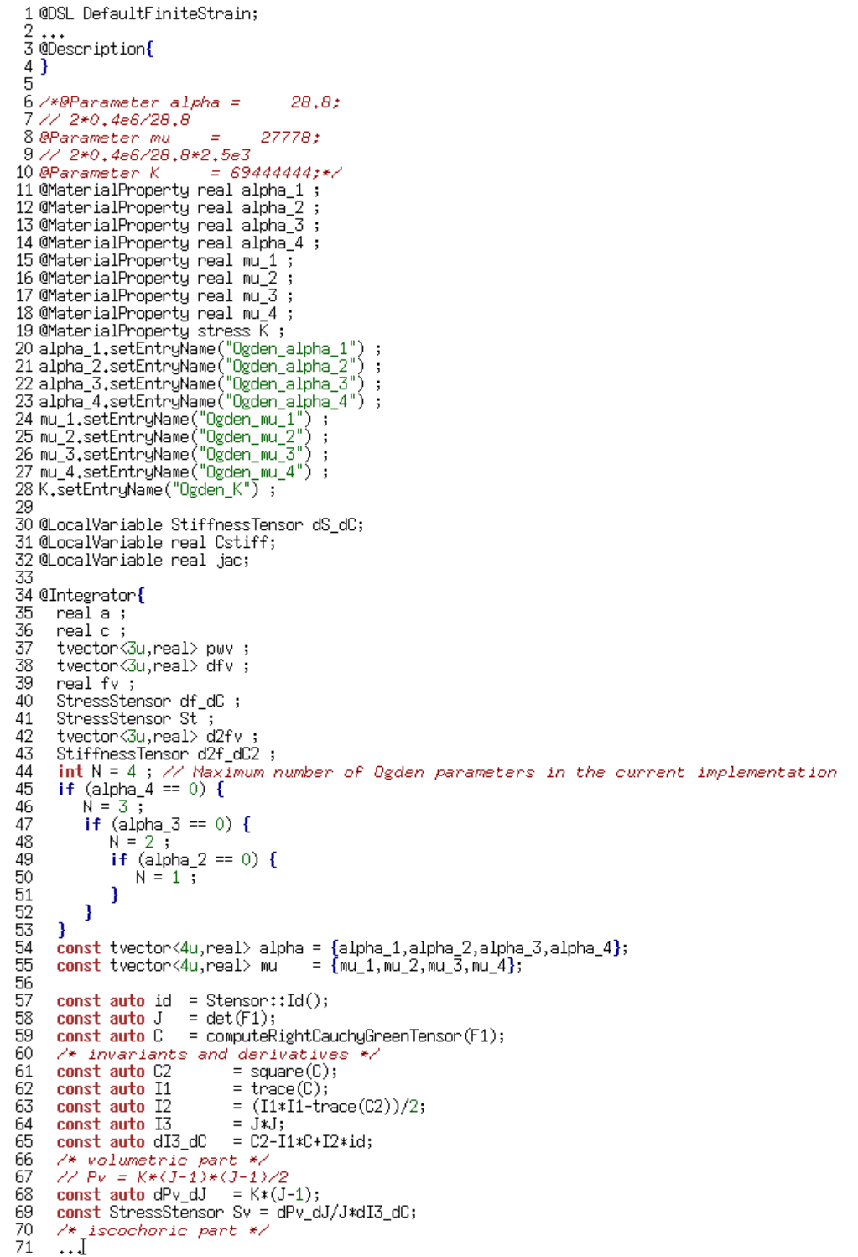
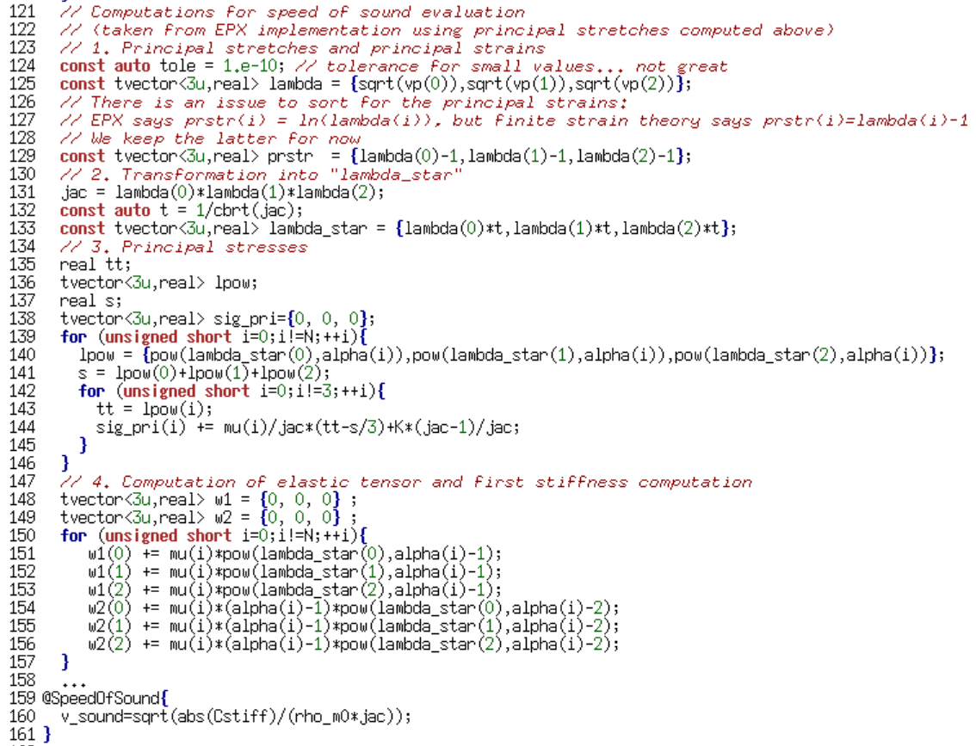

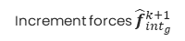
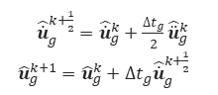
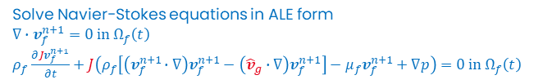
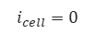
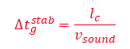
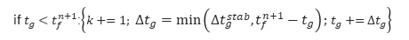
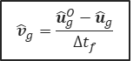
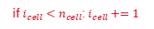
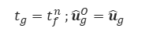
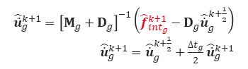
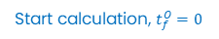

Complete algorithm and solving steps
Start calculation, $t_{f}^{O}=0$
$$t_{g}=t_{f}^{n} ;{\hat{u}}_{g}^{O}={\hat{u}}_{g}$$
${\hat{\dot{u}}}_{g}^{k+\frac{1}{2}}={\hat{\dot{u}}}_{g}^{k}+\frac{∆t_{g}}{2}{\hat{\ddot{u}}}_{g}^{k}$
${\hat{u}}_{g}^{k+1}={\hat{u}}_{g}^{k}+∆t_{g}{\hat{\dot{u}}}_{g}^{k+\frac{1}{2}}$
$$i_{cell}=0$$
Solve Navier-Stokes equations in ALE form
$∇∙v_{f}^{n+1}=0 in Ω_{f}\left(t\right)$
$ρ_{f}\frac{∂Jv_{f}^{n+1}}{∂t}+J\left(ρ_{f}\left[\left(v_{f}^{n+1}∙∇\right)v_{f}^{n+1}−\left({\hat{v}}_{g}∙∇\right)v_{f}^{n+1}\right]−μ_{f}v_{f}^{n+1}+∇p\right)=0 in Ω_{f}\left(t\right)$
Compute deformation gradient
Compute grid stress
Mfront behaviour
$${\hat{v}}_{g}=\frac{{\hat{u}}_{g}^{O}−{\hat{u}}_{g}}{∆t_{f}}$$
Increment forces ${\hat{f}}_{{int}_{g}}^{k+1}$
Compute stable time step $∆t_{g}^{stab}$
if $i_{cell}<n_{cell}$:$i_{cell}+=1$
Compute stable fluid time step $∆t_{f}^{stab}$
${\hat{\ddot{u}}}_{g}^{k+1}={\left[M_{g}+D_{g}\right]}^{−1}\left({\hat{f}}_{{int}_{g}}^{k+1}−D_{g}{\hat{\dot{u}}}_{g}^{k+\frac{1}{2}}\right)$
${\hat{\dot{u}}}_{g}^{k+1}={\hat{\dot{u}}}_{g}^{k+\frac{1}{2}}+\frac{∆t_{g}}{2}{\hat{\ddot{u}}}_{g}^{k+1}$
if $t_{g}<t_{f}^{n+1}$:$\left\{k+=1; ∆t_{g}=min\left(∆t_{g}^{stab},t_{f}^{n+1}−t_{g}\right);t_{g}+=∆t_{g}\right\}$
If $t_{f}^{n}<t_{f}^{end}$:$\left\{∆t_{f}=min\left(∆t_{f}^{stab},t_{f}^{end}−t_{f}^{n}\right);t_{f}^{n+1}=t_{f}^{n}+∆t_{g} ;n+=1 \right\}$
End calculation
$$∆t_{g}^{stab}=\frac{l_{c}}{v_{sound}}$$
/ 14

Slide 10
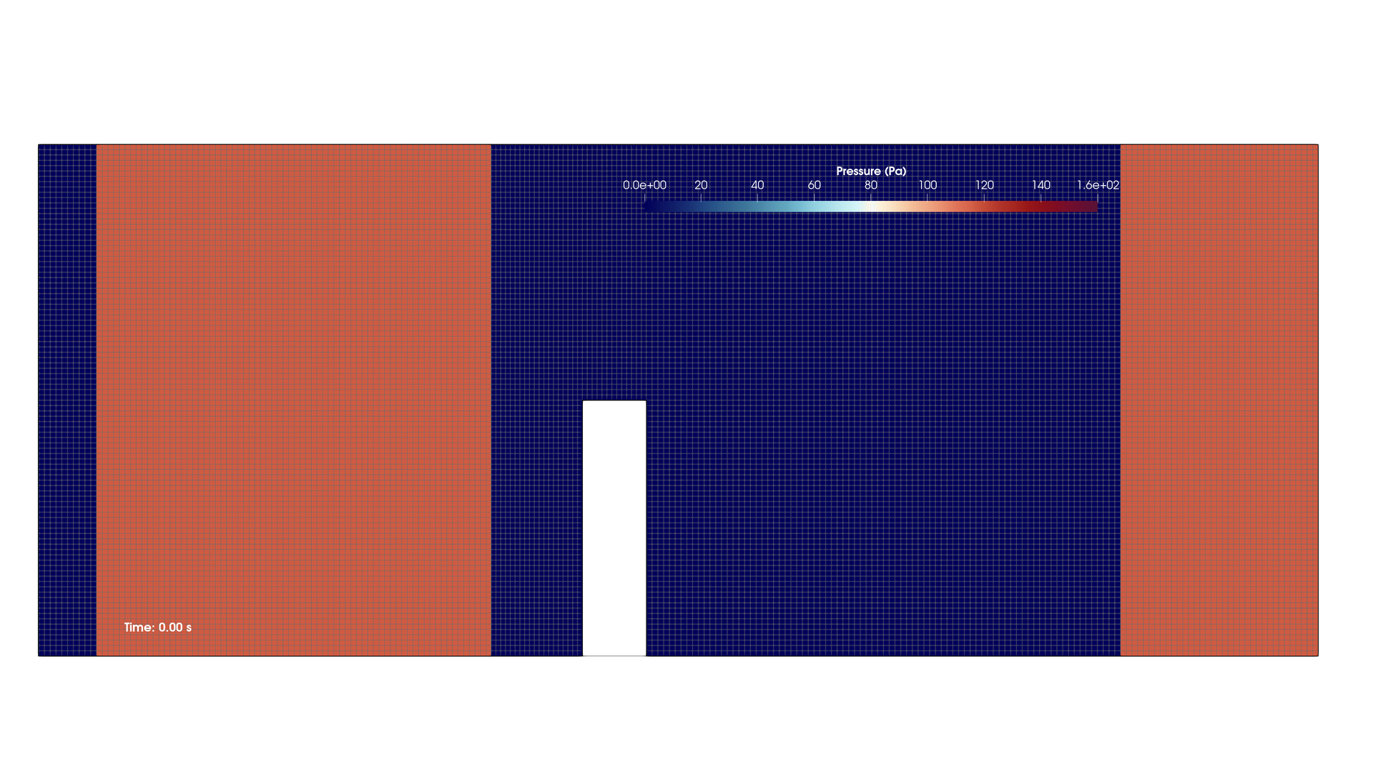
Test 0: proof-of-concept with EPX
Puscas M. A., Monasse L., Ern A., Tenaud C., Mariotti C., Daru V., A time semi-implicit scheme for the energy-balanced coupling of a shocked fluid flow with a deformable structure, Journal of Computational Physics, Volume 296, 2015, Pages 241-262
/ 14

Slide 11
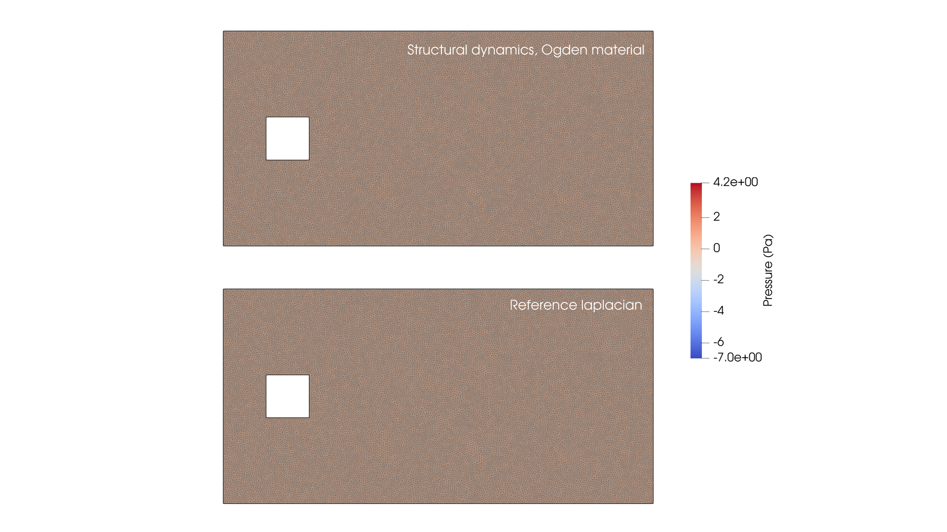
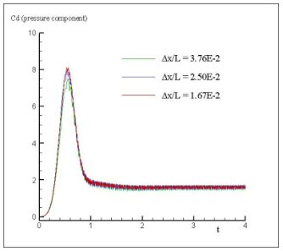
Test 1: square in translation
First test with TrioCFD using Mfront/MGIS implementation
Extend the robustness of the grid motion by preventing extreme shear in the elements in the corners
Colagrossi A., SPHERIC benchmark 6 : 2D Incompressible flow around a moving square in-side a rectangular
box. - 2D SPH Validation, https://www.spheric-sph.org/tests/test-06
/ 14

Slide 12
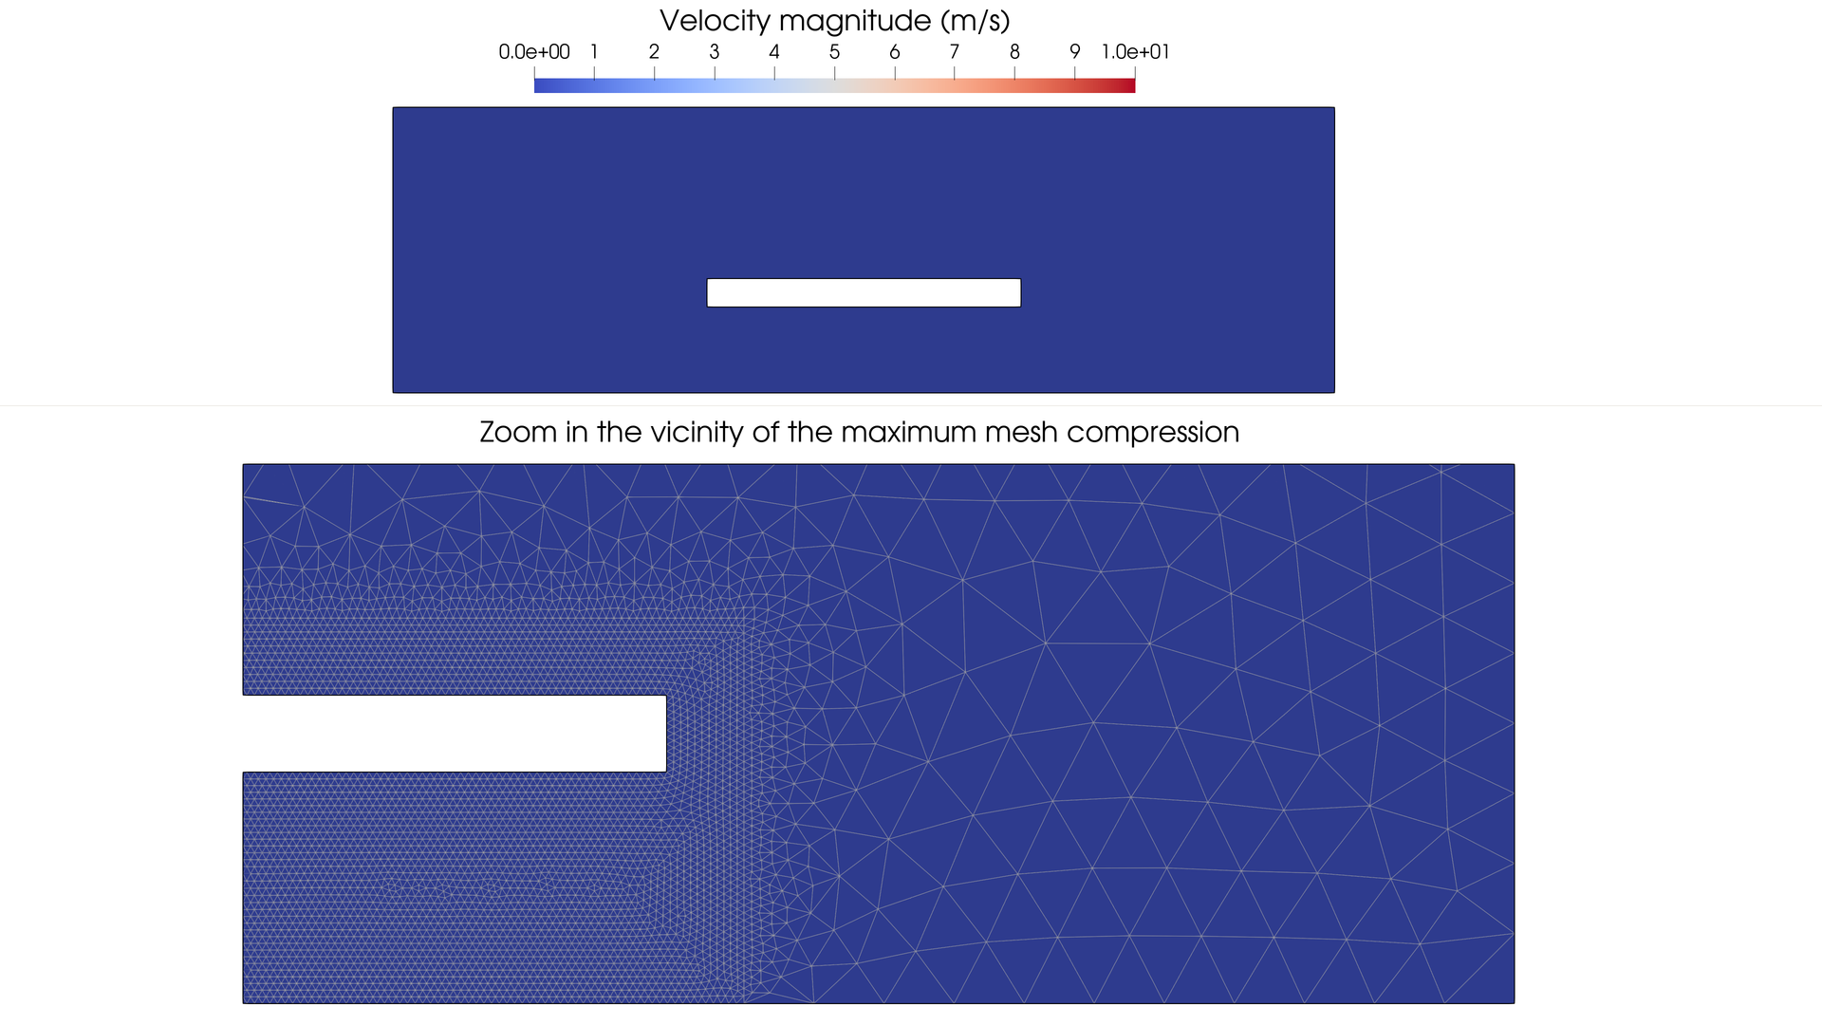
Test 2: towards extreme mesh compression
Objective: get close to contact within ALE framework
Fictitious parameters to tune finely to alleviate excessive pressure and sound speed increase
Efficiency helped by mass scaling with no restriction on the quality of the results
/ 14

Slide 13
Short conclusion
C
/ 14

Slide 14
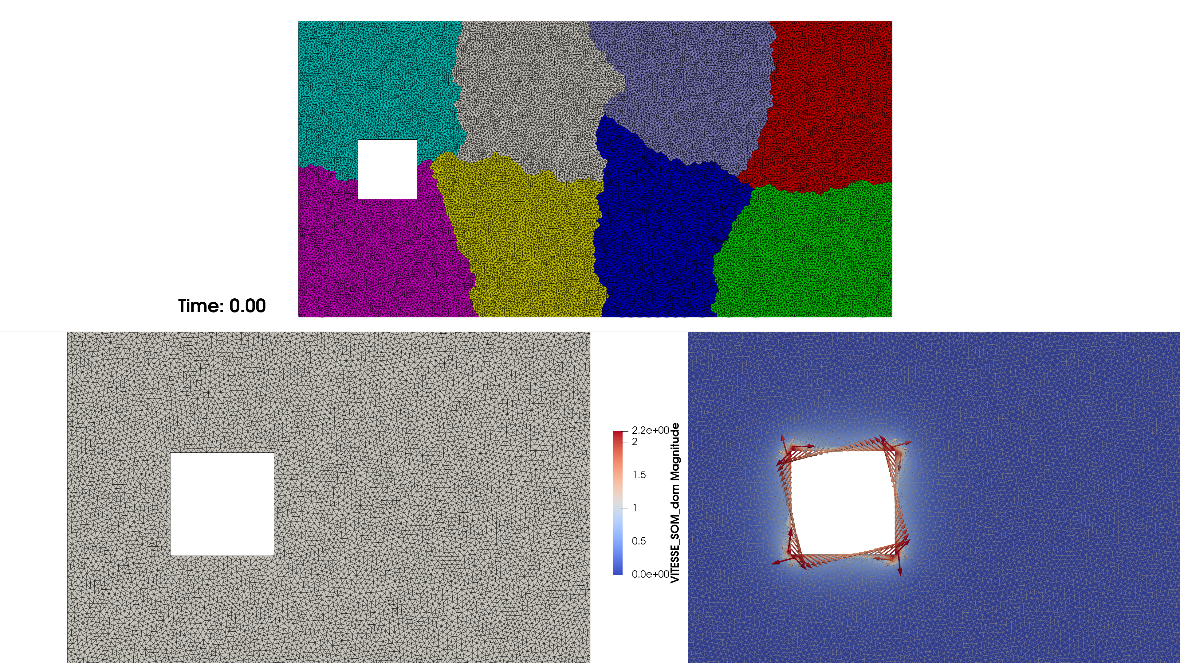
Ongoing work
Short term
Full validation of the implementation in TrioCFD and release within version 1.9.6
Test the limits
Publish!
Mid term
Advance in the delivery of reference solutions for immersed contact
(for instance to qualify immersed boundary solutions)
/ 14

Slide 15


